Slide 1
Cloud Architecture

Slide 2
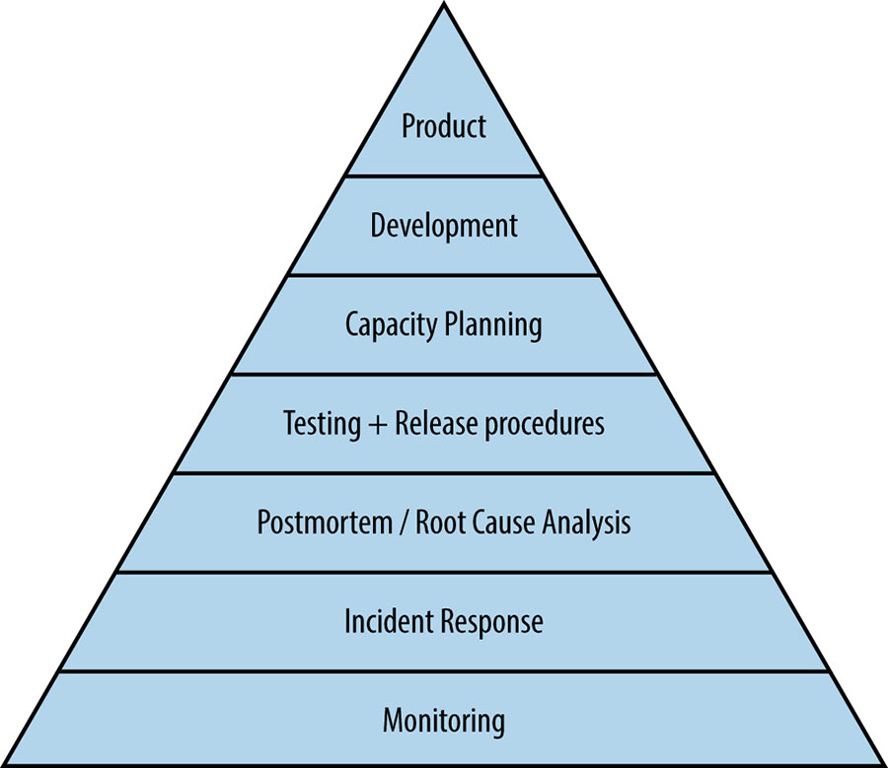
Site Reliability Engineering
Site reliability engineering is like you took software developers and made them sys admins. You end up with everything as code.
The main goals are to create scalable and highly reliable software systems
Notes:
https://landing.google.com/sre/books/

Slide 3
Designing a system
Start simple, iterate
Can't think about everything at once
Always trade-offs and context!
Watch out for recency bias!
Work is not done after deployment

Slide 4
Service Levels
Service Level Indicators (SLI)
Service Level Objectives (SLO)
Service Level Agreements (SLA)
Error Budgets
Notes:
What do your users expect from your service and does it behave that way?
Service Level Indicator is an attribute of your system that you measure, a metric. Could be page load time, average latency of your API, % of HTTP 500 errors.
Service Level Objective is a threshold that when the system is below it, an unacceptable number of customer are unhappy. A not-so-great SLO choice would be something that if it was not met, you would not want to be awoken by an alert at 3am.
Service Level Agreements are SLOs + contractual agreements with customers where if the SLO is missed then there is some form of compensation. Often times, your service may have SLOs that are more strict than the SLAs. Maybe SLO = 99.9% uptime but SLA = 99%.
https://aws.amazon.com/compute/sla/
You may define different Service Levels for different groups of users. Perhaps a "premium" tier of your service that guarantees <200ms latency, a "standard" tier that guarantees <300ms, and an "economy" tier with no guarantees. This would allow you to prioritize premium tier user traffic because that has a great cost if you cannot meet it's SLA.

Slide 5
Examples
SLI: The latency of successful, HTTP 200 responses
SLO: 95% of responses must be <200ms
SLA: No charge if 95% of responses exceed 300ms
Notes:
SLIs should represent user impacting metrics such as latency, error rates, and correctness. A bad SLI would be %cpu usage. The user doesn't care and we may not either as long as the service is working.
SLOs should represent the users "pain tolerance". Don't shoot for 100% on everything, it may be impossible, have a great cost, or hamstring your design. Oh and failure is inevitable so you wont meet it.
User "pain tolerance" may depend on the users! If our application is only ever used over a satellite connection by operators on an oil rig. Page load time may not be a good metric since no matter how fast the service is, the user will experience slow latency and they expect to. Shoot for good enough

Slide 6
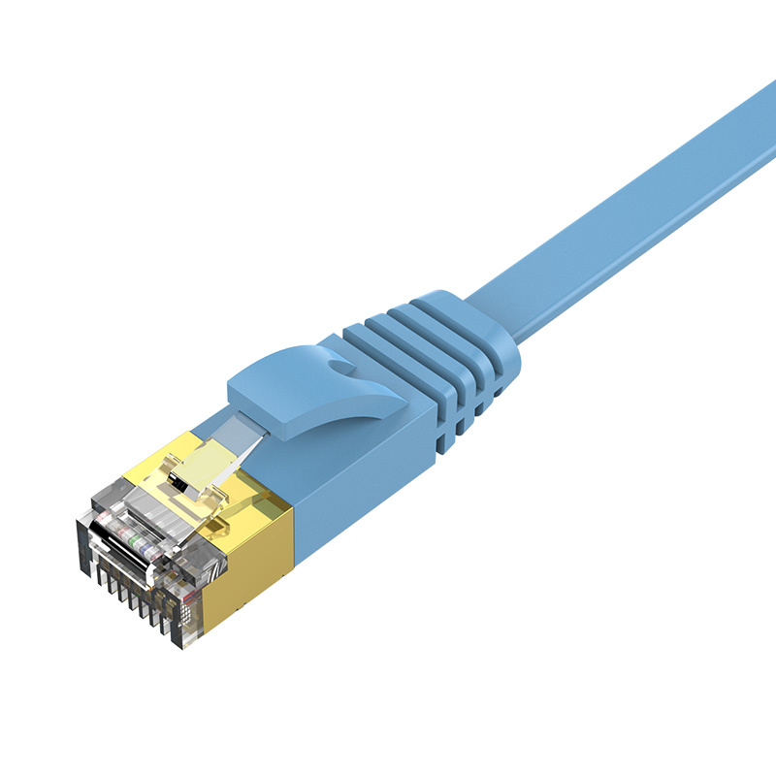
Be realistic!
Notes:
For a period of time in the 1960s, a research team was trying to develop a perfect conductor. The theory was that if they could grow a perfect crystal and metal wire, there would be no signal loss and, therefore, no errors in communication. And they succeeded in creating the perfect wire. However, when they tested it, sometimes there were still errors. Do you know why? It's because we live in a quantum mechanical universe, and the location of electrons moving down a conductor is probabilistic. So, occasionally, an electron will appear outside of the wire and get lost. Errors are going to happen. Loss is going to happen.
Ethernet was the first networking technology to embrace errors—to expect them—and to use them within the protocol. And well, it won!
Error budgets in your SLOs also give you a ton of flexibility. If you can be down for an hour to perform maintenance, that is going to be a much simpler deployment process than an app that cannot afford any downtime.

Slide 7
Microservices Review
Microservices Review

Slide 8
Microservices review
Multiple services that comprise your applications.
Break things apart by responsibility, trust boundaries, reuse, scaling needs, team, technology .... if it's worth it!
Don't make nanoservices

Slide 9
RESTful API review
HTTP urls and verbs
GET, POST, PUT, DELETE
Petstore API example- http://editor.swagger.io/
POST www.petstore.com/pets
{
"name": "frisky",
"color": "black",
"weight": "5lb"
}

Slide 10
Three Tier Architecture
Resiliency

Slide 11
Three-tier architecture
Presentation layer (networking)
Business logic layer (compute)
Data layer (storage)

Slide 12
Choosing solutions depends
What are you trying to optimize?
Scale
Latency
Cost
Privacy
Durability

Slide 13
Resiliency
Resiliency

Slide 14
Failure it not an option, it's mandatory
Hardware fails
Software fails
Networks fail
Process fails
Anticipate failure and plan for it
Don't rely on it
Monitor and test
Don't assume it always works
Review procedures and CHANGE THEM

Slide 15
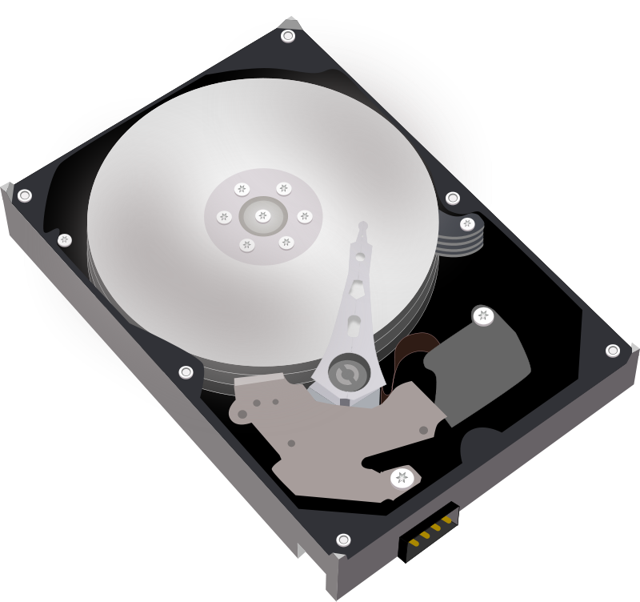
Failure due to loss
Hard-drive failures
Power outages
Node crashes
No SPOFs! Replicate everything!
N+2 architecture means a spare spare
Spread resources across failure domains
Node
Node
App
App
Notes:
Imagine designing a data center on the moon and what considerations that would take.

Slide 16
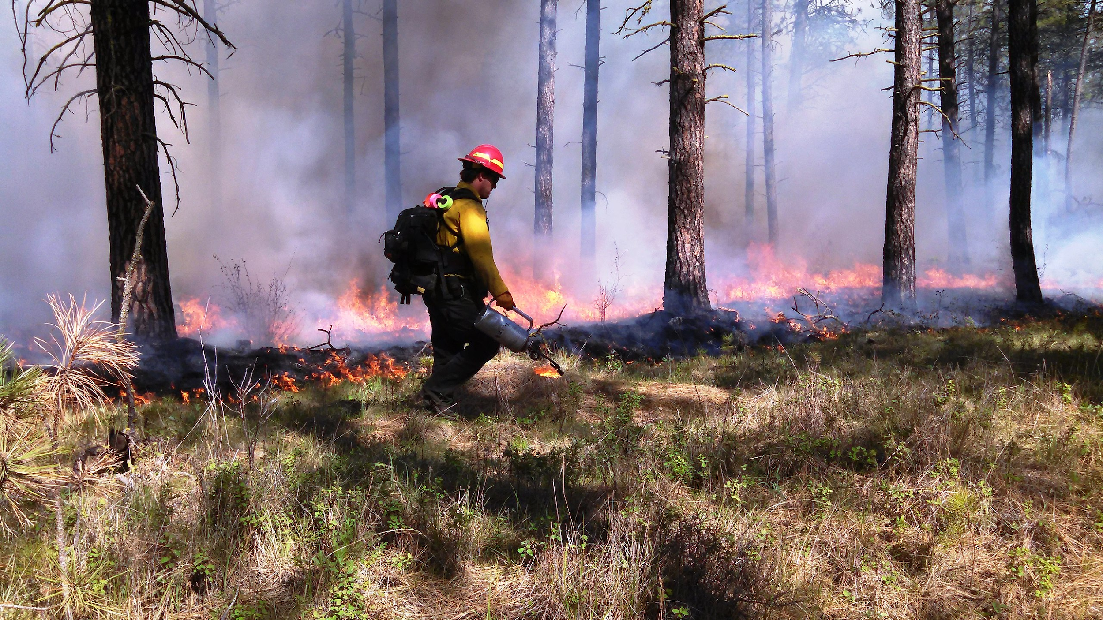
Chaos Engineering
Controlled burns in your system can show you how it copes with failure.
Notes:
https://en.wikipedia.org/wiki/Chaos_engineering
Public Domain IMAGE

Slide 17
Failure due to overload
When too much of a good thing (or bad thing) impacts your system.
Overload sources such as too many requests per second, too much data, or too much computing can lead to crashes, thrashes, and zombies.

Slide 18
Loss failures may cause overload
Load Balancer
800
800
800
App
App
App
1000 requests/sec max
1000 requests/sec max
1000 requests/sec max

Slide 19
Loss failures may cause overload
Load Balancer
1200
1200
0
App
App
App
1000 requests/sec max
1000 requests/sec max
1000 requests/sec max

Slide 20
Incast (fan in) overloads
So your workers scale, cool, but what about your frontend?
Frontend
Backend 1
Backend 2
Backend 3
...
Backend N
Notes:
Fan-in scenarios typically occur when it is cheaper to send a request than a response. For example, if we can handle 1000 requests of 10KB size, but each response is 100MB, we get hit with 100GB.

Slide 21
Feedback cycles
System handles 100 requests per second
110 requests are sent, 10 requests fail and are retried immediately
Now you have 120 requests per second, 20 requests fail
Now you have 140 requests, 40 will fail
Herd Behavior Examples
Temporary blip causes every client to retry immediately
Concurrent backups by every server at midnight

Slide 22
Measures to prevent cascading failure
Exponential backoff and jitter on retries
Graceful failure, throttling, and/or slowdown
Maintain spare capacity
Monitor used vs safe vs available capacity

Slide 23
Resiliency and High Availability
Highly Available (HA), or hot-hot, means if you have a loss, there is no interruption to service availability.
Hot-warm means you have a standby ready if something happens
Hot-cold means you are prepared to create a replacement if something happens

Slide 24
Backups
Backups

Slide 25
Backups and strategies
Perform tiered backups
Daily, weekly, yearly, etc
Example:
Daily backups ready to restore, past 7 days kept
Weekly backups stored in cold storage, past 4 weeks kept
Yearly backups stored in archives
Lazy deletion tiers
Mark data to be deleted -> after some time, move it to a "soft-deleted" location -> after some time, reap marked data
Test your restore procedures!
Notes:
Backups don't matter, the ability to restore does!
How long would/does it take? Is there a procedure?
Actually do it once and awhile
https://twitter.com/scottmcgready/status/1026875917963079682?lang=en

Slide 26

S3 has some useful features for backup!
Lifecycle policies
Storage Classes
Versioning
99.999999999% durability

Slide 27
Disaster Recovery
Disaster Recovery

Slide 28
Disaster Recovery & Business Continuity
What do we need?
Infrastructure
App
Data
RTO - Recovery Time Objective
Maximum time it takes to recover service availability after an outage
RPO - Recovery Point Objective
Interval of time since outage that data can be lost
I.E. Time between backups
Notes:
https://aws.amazon.com/disaster-recovery/

Slide 29
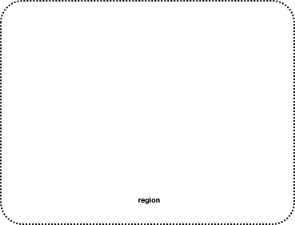






Resilient deployment
mysite.example.com
Autoscaling Group
Autoscaling Group
Availability Zone
Availability Zone
Cross-region Replication Feature
Notes:
Disaster Recovery in AWS: https://d1.awsstatic.com/whitepapers/Storage/Backup_and_Recovery_Approaches_Using_AWS.pdf

Slide 30
Instance Crash
mysite.example.com
Recreated by Autoscaling Group
Autoscaling Group
Autoscaling Group
Availability Zone
Availability Zone
Notes:
Disaster Recovery in AWS: https://d1.awsstatic.com/whitepapers/Storage/Backup_and_Recovery_Approaches_Using_AWS.pdf

Slide 31
Zone loss
mysite.example.com
Traffic shifts to other zone
Autoscaling Group
Autoscaling Group
Availability Zone
Availability Zone
Notes:
Disaster Recovery in AWS: https://d1.awsstatic.com/whitepapers/Storage/Backup_and_Recovery_Approaches_Using_AWS.pdf

Slide 32
Database loss
mysite.example.com
Slave is promoted
Autoscaling Group
Autoscaling Group
Availability Zone
Availability Zone
Notes:
Disaster Recovery in AWS: https://d1.awsstatic.com/whitepapers/Storage/Backup_and_Recovery_Approaches_Using_AWS.pdf

Slide 33
Regional outage
mysite.example.com
Autoscaling Group
Autoscaling Group
Availability Zone
Availability Zone
Notes:
Disaster Recovery in AWS: https://d1.awsstatic.com/whitepapers/Storage/Backup_and_Recovery_Approaches_Using_AWS.pdf

Slide 34
Regional outage
mysite.example.com
1. Use CFTs to create new stack different region
2. restore DB backup from s3
3. Change DNS to point to new loadbalancer
Autoscaling Group
Autoscaling Group
Autoscaling Group
Autoscaling Group
Availability Zone
Availability Zone
Availability Zone
Availability Zone
Notes:
Disaster Recovery in AWS: https://d1.awsstatic.com/whitepapers/Storage/Backup_and_Recovery_Approaches_Using_AWS.pdf

Slide 35
Monitoring, Alerting,
and Incident Response
Monitoring, Alerting,
and Incident Response

Slide 36
Measure everything!
* What are the system limits? how does it break when it breaks?
* Is everything working?

Slide 37
When to Alert and why?
SLO not being met, "Page on Pain"
Immediate attention required

Slide 38
Incident Response

Slide 39
Postmortems

